Slide 1

Virginia Sickle Cell Disease ECHO* Clinic
July 10th , 2019
*ECHO: Extension of Community Healthcare Outcomes

Slide 2
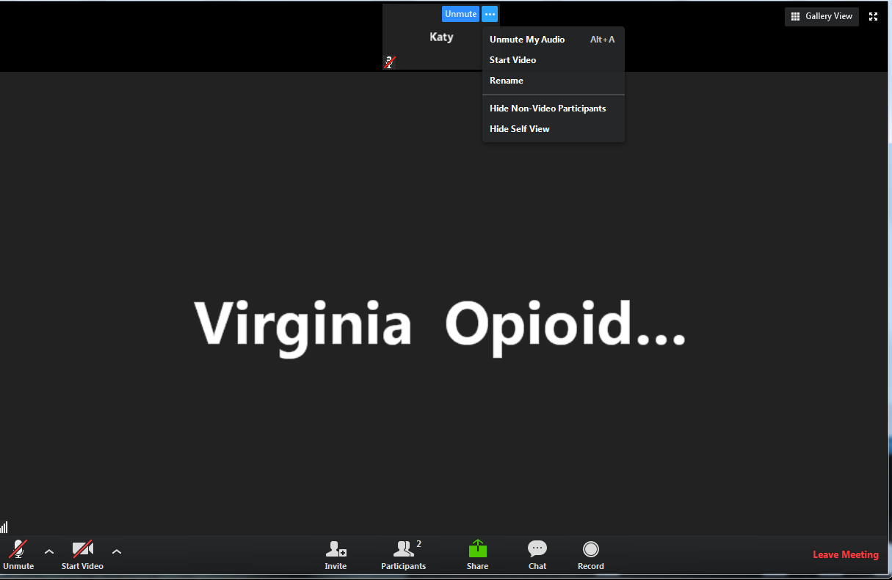

Helpful Reminders
Rename
Rename your Zoom screen, with your name and organization

Slide 3
Helpful Reminders
You are all on mute
please unmute to talk
If joining by telephone audio only, *6 to mute and unmute
Unmute

Slide 4
Helpful Reminders
Please type your full name and organization into the chat box
Use the chat function to speak with IT or ask questions
Chat Box

Slide 5




VCU Sickle Cell Disease ECHO Clinics
Monthly 2 hours tele-ECHO Clinics
Every tele-ECHO clinic includes 2 case presentations and a didactic presentation
Didactic presentations are developed and delivered by inter-professional experts in Sickle Cell Disease care and management
Website Link: http://vcuhealth.org/sicklecellecho

Slide 6
Hub Introductions
VCU Team
Clinical Director | Wally R Smith, MD
Administrative Medical Director ECHO Hub and Principal Investigator | Wally R Smith, MD
Clinical Expert Didactic Presentation Program Manager IT Support Administrative Assistant Clinical Social Worker Patient Navigators Prior Authorization Specialist | India Y Sisler, MD Thokozeni Lipato, MD Jennifer Newlin, PA Mica Ferlis, NP Caitlin McManus, NP Nancy Green, MD Shirley Johnson, LSW Daniel M Sop, M.Sc.Eng Donna Casey Taylor Elliott, MSW Marla Brannon, BSW Stefani Vaughan-Sams Austin Hardy

Slide 7
Spoke/ Participant Introduction
Name
Organization

Slide 8

What to Expect
Case presentation #1 – Jennifer Vaughn, MD
    Case summary
    Clarifying questions
    Recommendations
    Recap
Didactic Presentation
  Title: Hydroxyurea adherence:
  Risks, Monitoring, Intervention
  Presenters: Nancy Green, MD
Case presentation #2 – Julio Silvestre, MD
    Case summary
    Clarifying questions
    Recommendations
    Recap
Closing and questions
Lets get started!
Case Presentation #1

Slide 9

Case Presentation #1
12:50PM to 1:15pm [25 min]
  Presentation: (5 min)
  Case summary: Clinical Hub Lead(5 min)
  Clarifying questions- Spokes (participants) 4 min:
  Clarifying questions – Hub (4 min):
  Recommendations – Spokes (participants) 2 min:
  Recommendations – Hub (2 min):
  Recap Case /Recommendations- Hub (3 min):

Slide 11
Didactic Presentation

Slide 12
Hydroxyurea adherence:
Risks, Monitoring, Intervention
Nancy Green, MD
Professor of Pediatrics
Division of Hematology, Oncology and Stem Cell Transplantation
Columbia University
ECHO VCU
7/10/2019
This work is supported by:
R21NR013745
R01NR017206

Slide 13
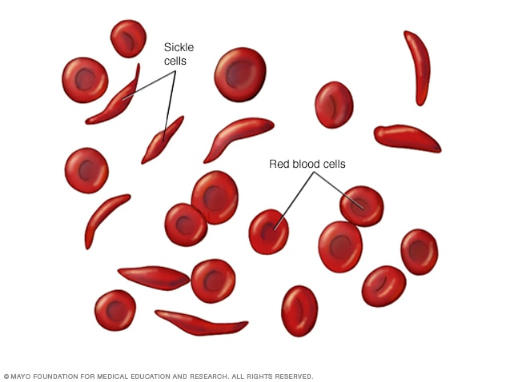
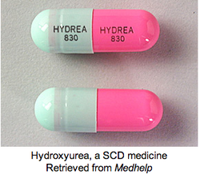
Sickle Cell Disease
An inherited blood disease—
In the U.S. most common in people of African ancestry
Red blood cells are unstable, leading to:
Anemia
Episodes of pain and multi-organ disease
Reduced lifespan
Hydroxyurea
(HU)

Slide 14
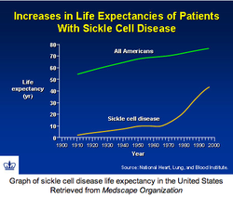
Progress for survival in SCD (U.S.)
All Americans versus SCD (1970-2000)
1970 - Paying attention; 1980 - Penicillin
1990 – HU; 2000 - TCD stroke prevention
Still a long way to go!
http://pbsblood.weebly.com/diagnostic-tests-treatments--prognosis.html

Slide 15
Medical Treatment Adherence
Adherence describes the degree to which a patient correctly follows medical advice.
Usually refers to medication compliance
For chronic illnesses, poor adherence is the primary reason for ineffective treatment
U.S.: Estimated that 1/3 of medication uses are poorly adherent

Slide 16
How is treatment adherence measured?
Self-report – considered as the lowest level of evidence
Pharmacy refills – good but often not accessible
Biomarkers – often used to monitor medication adherence and/or effectiveness
Indicator of disease processes or responses to the intervention
  Best when the biomarker directly reflects the intervention or disease
Commonly used - Standardized measurement:
  Drug levels – e.g. blood level of the drug or metabolite
  Target effect of therapy:
      Most common: Diabetes Hemoglobin A1C = 5-6%
      Hypertension: Standardized blood pressure target

Slide 17
Excellent biomarker of disease severity for Sickle cell:
“Fetal hemoglobin” (HbF) – a minor component of blood
In SCD, levels vary between 1% - 25% of blood
Higher levels fewer disease complications (Platt NEJM 1994)
Variability in HbF accounts for heterogeneity of disease severity
Hydroxyurea (HU): Widely used FDA-approved drug for Sickle cell
Its major action: markedly induces HbF levels
= Reversible and Individualized
Polygenic
Depends on drug exposure
Must be used daily
A model for individualized biomarkers for adherence

Slide 18
Systematic review:
Medication adherence among children with SCD
HU, penicillin prophylaxis, Iron chelation
“Moderate adherence is typical”
Adherence rates: 16% - 89%
Walsh KE, Pediatrics 2014

Slide 19
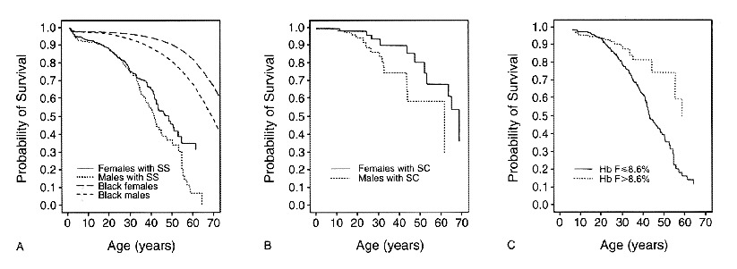
Biomarker: Higher HbF is Associated with Lower Mortality
And fewer disease complications in adults with SCD
No “ceiling effect” – higher = better
Higher HbF
Sickle cell Survival – SCCS
(single center)
Lower HbF
Platt NEJM 1994
Steinberg JAMA 2001
Smith W Pain Med 2011
Gardner Blood 2016

Slide 20
Fetal hemoglobin (HbF) response to HU therapy in children:*
Pre-treatment baseline to maximum tolerated dose (MTD)
mean 5.5% to mean 17.6%
*Adults too, but
Often attenuated
Compared to children
Steinberg JAMA 2003
Ware RE Blood, 2002

Slide 21
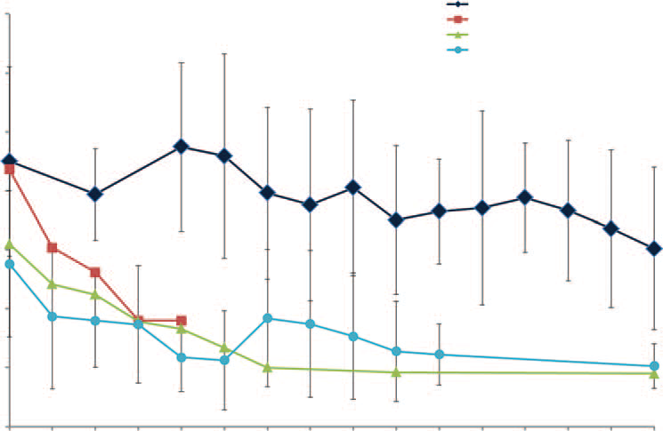
HU Long term effect on HbF
Sustained in children for ≥ 12 years
HbF%
25
Long term HU
20%
20
20% HbF
15
Untreated U.S.
10
Untreated
Jamaica, British
5
0
0
5
10
15
Years on HU
Hankins Medicine 2014

Slide 22
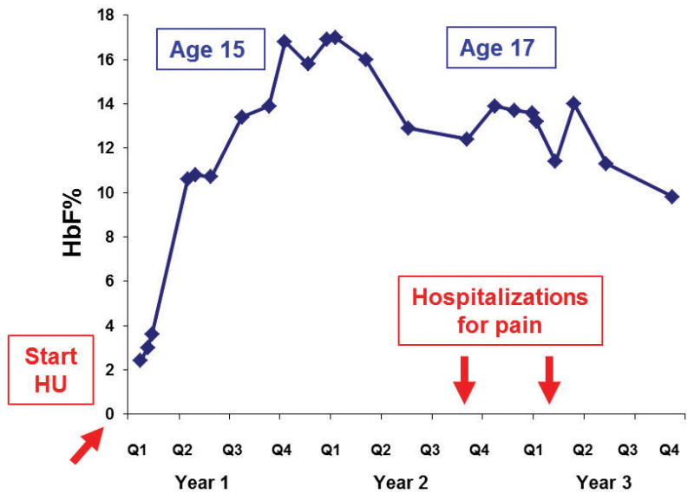
Here’s our 15 year-old patient:
ADHERENCE to HU During Adolescence…
HbF

Slide 23
2-site retrospective evaluation - ages 10-18 years (N=75):
Deviation from “Personal Best” HbF: 70% have reduced HbF
Ad
Ad
“Adherent” Patients
Site 1
HbF%
11.7%
HbF
40.1%
HbF
HbF: Pre-HU PBest Recent
HbF: Pre-HU PBest Recent
Non-adherent Patients
Site 2
Pre-HU PBest Recent
Pre-HU PBest Recent
Green PBC
2016
HbF Assessments
HbF Assessments

Slide 24
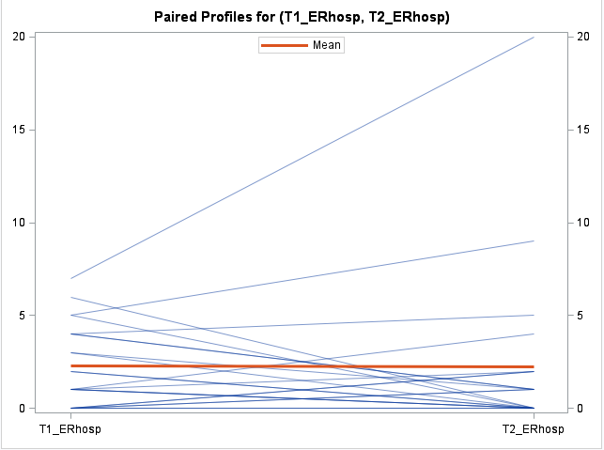
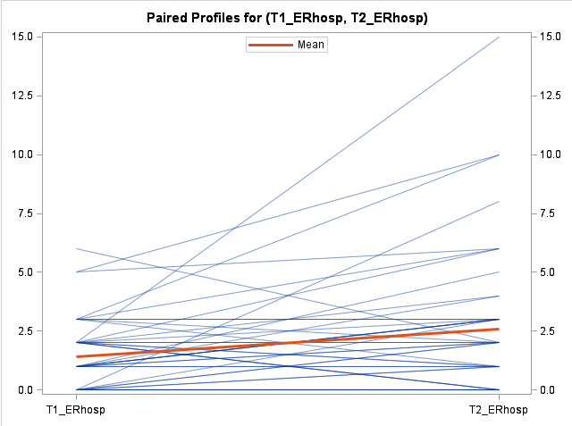
Non-adherent patients’ Urgent care use increased with reduced HbF:
ED + Hospitalizations (also Length of stay)
Comparing 1-year periods at 2 different time points:
at Personal Best HbF and at a cross-sectional assessment (p<0.01)
Adherent group
Poorly adherent group
PBest
Recent
assessment
PBest
Recent
assessment
Green PBC 2016
PBest
Recent assessment

Slide 25
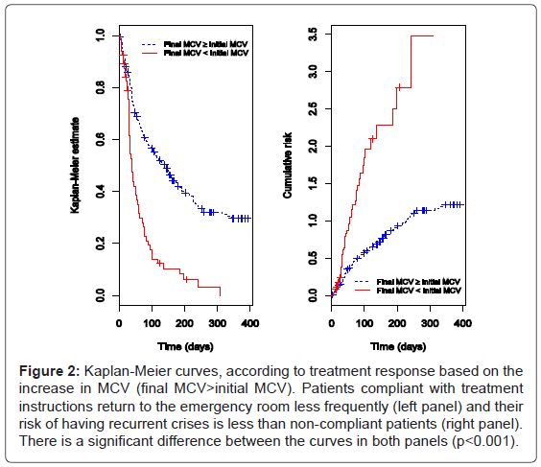
Other Biomarker for HU Use & Adherence:
RBC mean corpuscular volume (MCV)
Also = dose-dependent
When MCV is higher than baseline:
Fewer painful crisis ED visits (p<0.001)
Queiroz 2013

Slide 26
HABIT Trial:
“Hydroxyurea Adherence for
“Personal Best” in Sickle Cell Treatment”
Pilot trial aimed to:
1) Improve HU parent-child use via intervention led by Community Health Workers (CHWs)
2) Assess feasibility & acceptability of intervention
3) Estimate impact to plan sample size for efficacy trial
Co-PI: Arlene Smaldone
Participating sites: Columbia, Montefiore (site PI Manwani)

Slide 27
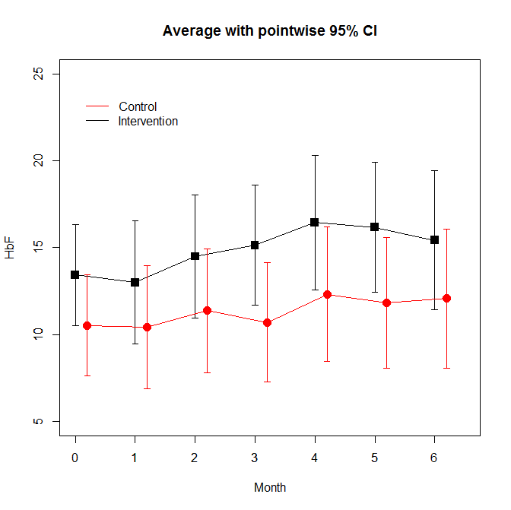
HABIT Pilot study: PROMISING RESULTS
Pilot: 6-month two-arm RCT
28 youth-parent dyads at the 2 sites
CHW-led intervention: home visits, plus text reminders
Results:
Improved HbF, HU pharmacy refills
Improved generic & SCD QoL
Feasible
Acceptable
HbF
Study Months 0-6

Slide 28
Completing the HABIT intervention (6 months):
Impact on Health-related Quality of Life (QoL)
Youth:
Generic Health QL: Improved
Total score (10 points)
Emotional subscale (15 points)
PedsQL Sickle Cell Disease Module: Improved
Worry (30 points)
Emotions (37 points)
Communication (18 points)
Parents:
Generic Health QL: No change
Smaldone, J. Pediatrics 2018

Slide 29
HABIT intervention
Greater number of perceived barriers to HU was
associated with poorer health-related QoL in youth
Impacts Generic QOL and Sickle QOL
Barriers – both youth and parents:
  Forgetting
  Tired of taking medications
  Don’t know (or see) benefits
  Worried about side effects
What’s next?
Smaldone PBC 2019
Badawy Ped Hematol Oncol 2018

Slide 30
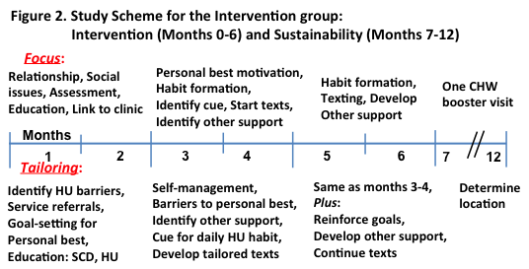
HABIT Efficacy study: Underway
12-month RCT
104 dyads at 4 sites:
Columbia
Montefiore (Manwani)
CHOP (Smith-Whitley)
Cohen-LIJ (Aygun)

Slide 31
Determining and using Personal Best
Personal Best = highest HbF level on HU (when stable)
Manual process to determine this individual value
And determine correlation with clinical complications
Computational methods to scale up?
  Hundreds of patients at each institution
  Identify poor health behavior
  Determine trial eligibility
  Measure impact of intervention trials
  Motivate to improve health behavior

Slide 32
Lessons learned
HU adherence may be poor
Adherence over time can be tracked using biomarkers
Important for improved health and QoL
Providers: monitor its use!
Also –
Asking about adherence doesn’t usually help
Coach patients on their personal best HbF
Barriers: therapeutic nihilism (“it won’t work for me”)
Barriers: informational, logistical, social
Community health workers, navigators, other community members
may be a more effective messenger and partner for patients & families

Slide 33
Thanks for your attention
Questions?

Slide 34
Case Presentation #2
1:40- 2:00pm [25 min]
  Presentation: (5 min)
  Case summary: Clinical Hub Lead(5 min)
  Clarifying questions- Spokes (participants) 4 min:
  Clarifying questions – Hub (4 min):
  Recommendations – Spokes (participants) 2 min:
  Recommendations – Hub (2 min):
  Recap Case /Recommendations- Hub (3 min):

Slide 36
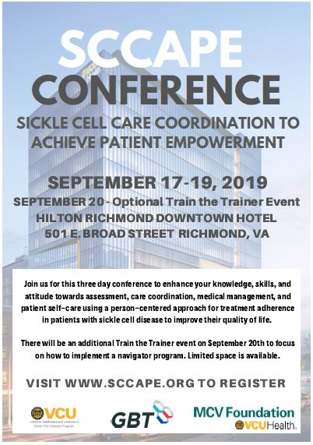

Slide 37
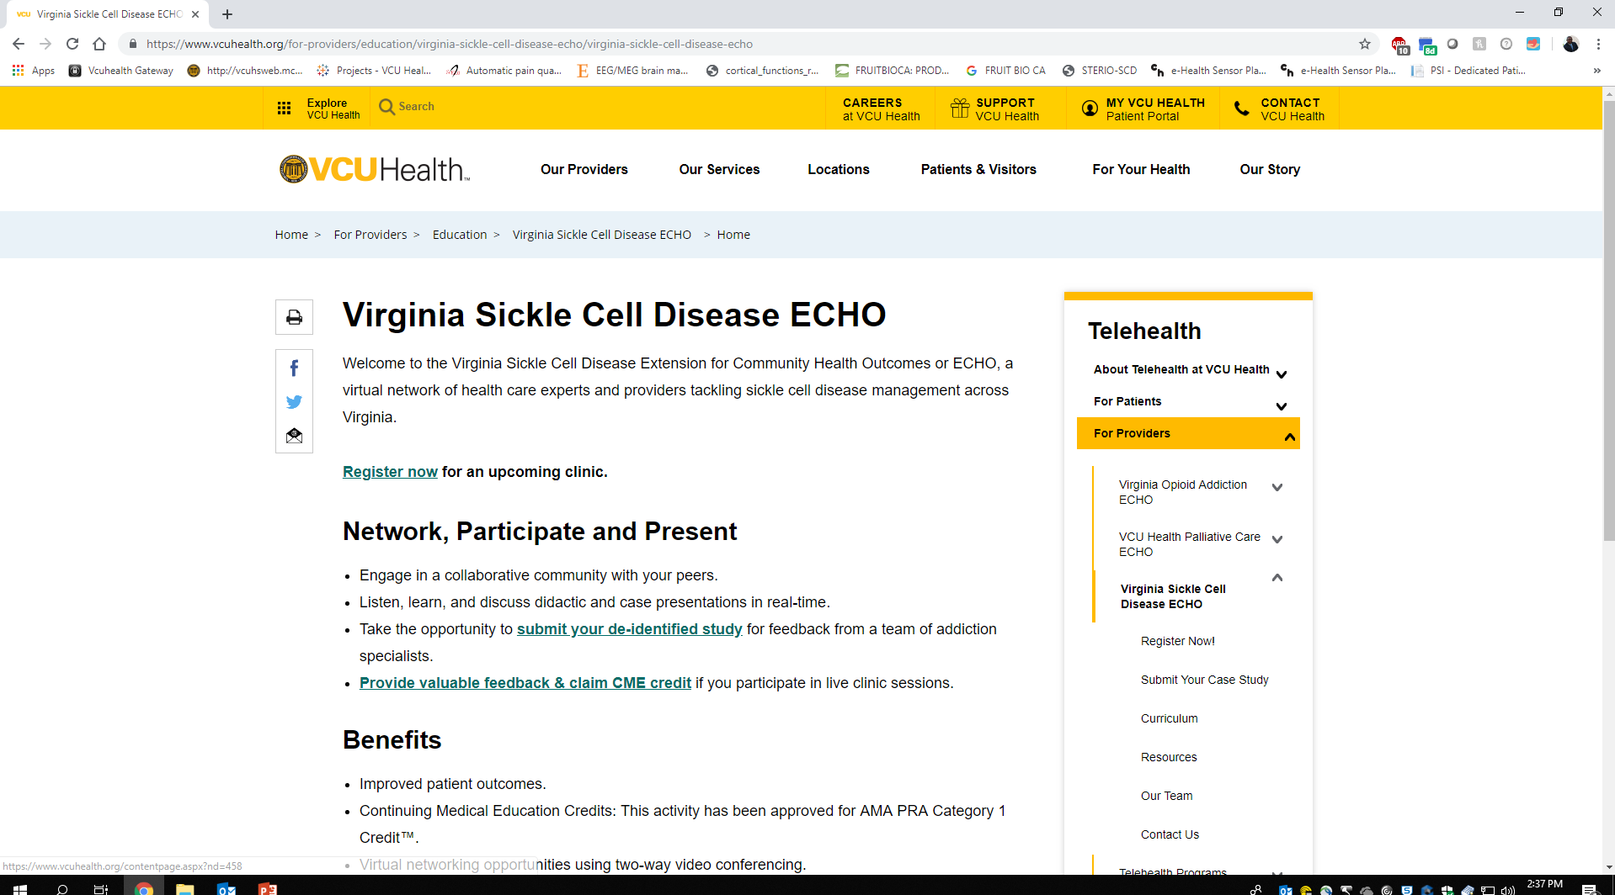
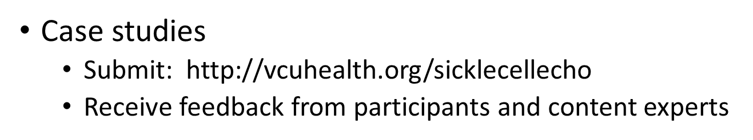
Case Studies

Slide 38
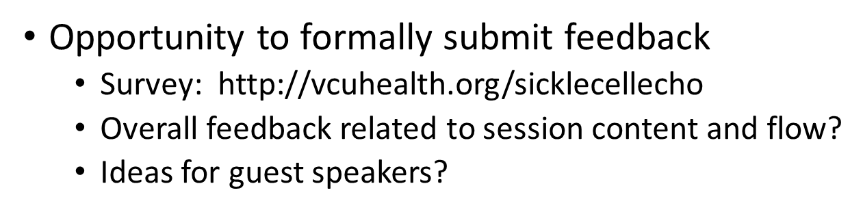
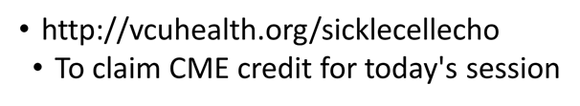
Feedback & CME’s

Slide 39
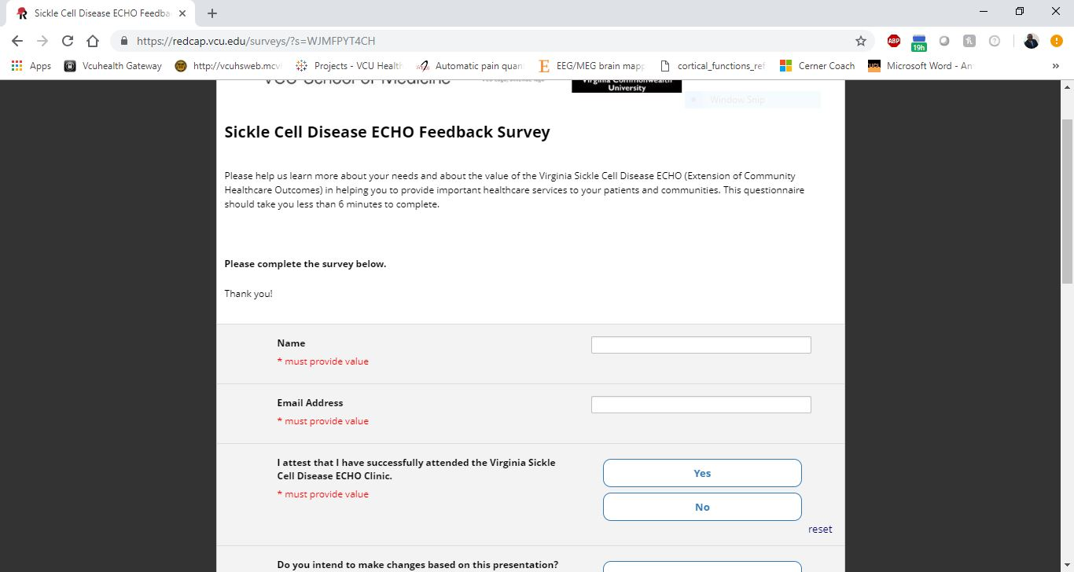
Access Your Evaluation and Claim Your CME

Slide 40
THANK YOU!

