Slide 1
Virginia Sickle Cell Disease ECHO* Clinic
February 6th , 2019
*ECHO: Extension of Community Healthcare Outcomes

Slide 2
Helpful Reminders
Rename
Rename your Zoom screen, with your name and organization

Slide 3
Helpful Reminders
You are all on mute
please unmute to talk
If joining by telephone audio only, *6 to mute and unmute
Unmute

Slide 4
Helpful Reminders
Please type your full name and organization into the chat box
Use the chat function to speak with IT or ask questions
Chat Box

Slide 5
VCU Sickle Cell Disease ECHO Clinics
Monthly 2 hours tele-ECHO Clinics
Every tele-ECHO clinic includes 2 case presentations and a didactic presentation
Didactic presentations are developed and delivered by inter-professional experts in Sickle Cell Disease care and management
Website Link: http://vcuhealth.org/sicklecellecho

Slide 6
Hub Introductions
VCU Team
Clinical Director | Wally R Smith, MD
Administrative Medical Director ECHO Hub and Principal Investigator | Wally R Smith, MD
Clinical Expert Didactic Presentation Program Manager IT Support Administrative Assistant Clinical Social Worker Patient Navigators Prior Authorization Specialist | India Y Sisler, MD Thokozeni Lipato, MD Jennifer Newlin, PA Mica Ferlis, NP Wally Smith, MD Shirley Johnson, LSW Daniel M Sop, M.Sc.Eng Donna Casey Taylor Elliott, MSW Marla Brannon, BSW Stefani Vaughan-Sams Austin Hardy

Slide 7
Spoke/ Participant Introduction
Name
Organization

Slide 8
What to Expect
Case presentation #1 – Mica Ferlis, NP
Case summary
Clarifying questions
Recommendations
Recap
Didactic Presentation
Title: The Difficult Sickle Cell Patient
Presenter: Wally R Smith, MD
Case presentation #2 – Lerla Joseph, MD
Case summary
Clarifying questions
Recommendations
Recap
Closing and questions
Lets get started!
Case Presentation #1

Slide 9
Case Presentation #1
12:50PM to 1:15pm [25 min]
Presentation: (5 min)
Case summary: Clinical Hub Lead(5 min)
Clarifying questions- Spokes (participants) 4 min:
Clarifying questions – Hub (4 min):
Recommendations – Spokes (participants) 2 min:
Recommendations – Hub (2 min):
Recap Case /Recommendations- Hub (3 min):

Slide 11
Didactic Presentation

Slide 12
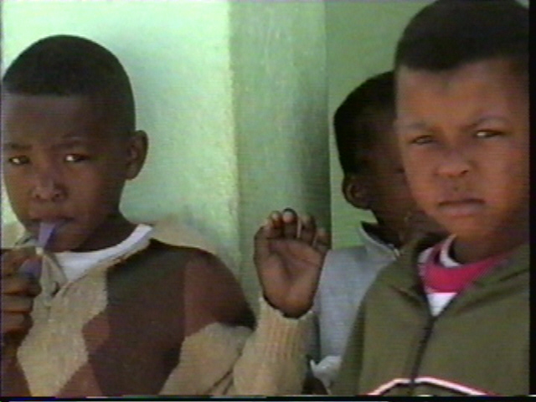
The Difficult Sickle Cell Patient
Wally R. Smith, MD
Florence Neal Cooper Smith Professor of Sickle Cell Disease
Vice Chair for Research, Div. of General Internal Medicine

Slide 13
The Difficult SCD Patient
A 19-year-old African –American man with SCD presents to the ED with progressive leg and back pain. His hooded sweatshirt is pulled over his eyes, he is wearing headphones, and is singing along to an unheard tune.

Slide 14
The Difficult SCD Patient (cont’d)
Pain is 9 on a 10 point scale.
Nurse: “Really?”
Requests a specific dose of a specific opioid
Request met with doubt and disdain
“Drug seeker, abuser”

Slide 15
Becoming a Difficult SCD Patient
17yo AA with SCD.
Admitted 8/3/09 for uncomplicated painful crisis
Ran out of Tylenol #3, pain increased.
Had Vicodin from prior crisis, took, but no relief.
PMH
2000-2009 hematologist at Portsmouth, and Newport News
4/16/1998-2000 in Richmond
3-4 clinic visits, 3 ED ‘s 2 admits

Slide 16
Ensuing History
Numerous ED visits, admissions 2009-2015.
Few clinic visits.
Became one of the top 5 SCD utilizers at the hospital.

Slide 17
August - September 2015
Admission for sepsis (blood infection) and crisis 7/29/15-8/22/15.
Infected Port-A-Cath .
Arrived in cardiac arrest 9/24/15.
IV was already in arm, appears to have been at another hospital earlier 9/23/15.
Dextrose X2 for initial glucose of only 17
Had been seen in ED two days earlier with crisis and a UTI. Sent home.
Expired

Slide 18
SCD and the “Difficult Patient” Conundrum
Convergence of SCD’s unique political, historical, cultural, medical, and psychological dimensions → distressing plight for pts.
Often classified as “difficult.”
Bergman EJ, Diamond NJ. Sickle cell disease and the "difficult patient” conundrum. Am J Bioeth. 2013;13(4):3-10. doi: 10.1080/15265161.2013.767954. PubMed PMID: 23514384.

Slide 19
SCD and the “Difficult Patient” Conundrum (cont’d)
Traditional understanding of the “difficult” patient warrants reevaluation
Nuanced dimensions of SCD
Barriers to care particular to SCD
Need to redefine orthodox notions of the “difficult” patient.
Bergman EJ, Diamond NJ. Sickle cell disease and the "difficult patient” conundrum. Am J Bioeth. 2013;13(4):3-10. doi: 10.1080/15265161.2013.767954. PubMed PMID: 23514384.

Slide 20
Prodigy and “The Most Racist Judge in Nassau County”
Play Audio
https://www.youtube.com/watch?v=WRdR-tX6eiw&t=24s

Slide 21
Survival in SCD may be going down due to poor quality of care
1979 to 2005
The overall SCD mortality rate increased 0.7% (p<0.001) each year
The pediatric SCD mortality rate decreased by 3% (p<0.001)
The adult (>19 years of age) mortality rate increased by 1% (p<0.001) each year
It seems unlikely that this increase is due merely to an influx of younger patients surviving to adulthood and may reflect a lack of access to high-quality care for adults with SCD
Lanzkron S, Carroll CP, Haywood C Jr. Mortality rates and age at death from sickle cell disease: U.S., 1979-2005. Public Health Rep. 2013 Mar-Apr;128(2):110-6. PubMed PMID: 23450875; PubMed Central PMCID: PMC3560868.

Slide 22
Types of Difficult SCD Patients
Medical
Attitudinal (patient)
Attitudinal (clinicians)
Social (for patient)
Cultural (for the treating team)
Financial
Transportation-access to care
Opioids (just, yet safe prescribing)

Slide 23
SCD is Difficult
Best of times
After 100 years of neglect, a phalanx of new SCD drug treatments, stem cell/bone marrow transplant, and gene therapy
Led by industry
Incentivized by government
Worst of times
Patients often aren’t offered, and often don’t/won’t adhere to hydroxyurea, the only FDA-approved SCD drug treatment
New treatments will be expensive, may be inaccessible

Slide 24
SCD is Difficult
Age of Wisdom
Number of patients with SCD in US, in world better determined
Biology(ies) of SCD far better understood
Elucidation of genetics of SCD has spawned an entire biomedical scientific genre
Age of Foolishness
Adequate opioid drug treatment for SCD, chronic non-cancer pain now being denied, as part of war on opioid abuse and opioid-induced deaths

Slide 25
SCD is Difficult
Epoch of Belief
Pediatricians, NMA, ASH, CDC, HRSA, NIH believe SCD is important, and they should pursue policies to better care for SCD
Epoch of incredulity
SCD Patients still don’t trust health care system
Adult doctors, hematologists, even generalists, don’t or won’t take care of SCD patients

Slide 26
SCD is Difficult
Season of Light
Patients with SCD living longer than ever before
2/3 of SCD patients are now adults
Season of Darkness
The growth in lifespan really is really due to childhood care, not adult care
The survival curve suggests adults with SCD cannot look forward to further extensions of life right now

Slide 27
SCD is Difficult
Spring of Hope
We have everything before us
We are all going direct to Heaven
Winter of despair
We have nothing before us
We are all going direct the other way

Slide 28
“To know syphilis is to know medicine.”
sickle cell
Sir William Osler

Slide 29
Need for Primary Care in SCD

Slide 30
The Prism of SCD
“Difficult” Patient
Avoid
Don’t give in
Don’t allow abuse (of you or opioids)
Vulnerable Patient
Adapt Medical care
Accept and modify patient attitude to foster trust
Adjust clinician attitudes to foster trust
Look for social support for patient
Cultural sensitivity/competence for treating team
Financial support for treaters and patient, caregivers
Transportation, improved access to care
Opioids- adopt just, yet safe prescribing

Slide 31
Sickle Cell Adult Provider Network
www.scapn.net
2/3 of all SCD patients are adults
Research and Resources for Collaboration needed
SCAPN=Network with Adult Sickle Cell Providers
Patient Care Resources

Slide 32
SINERGe: HRSA Northeastern Demonstration Collaborative
Funded by Health Resources and Services Administration
7 States
Increase number of providers of adult care in SCD
Increase number of providers prescribing hydroxyurea
Increase number of patients receiving care from SCD –savvy providers

Slide 33
SCCoPE
Sickle Cell Community Physician Exchange

Slide 34
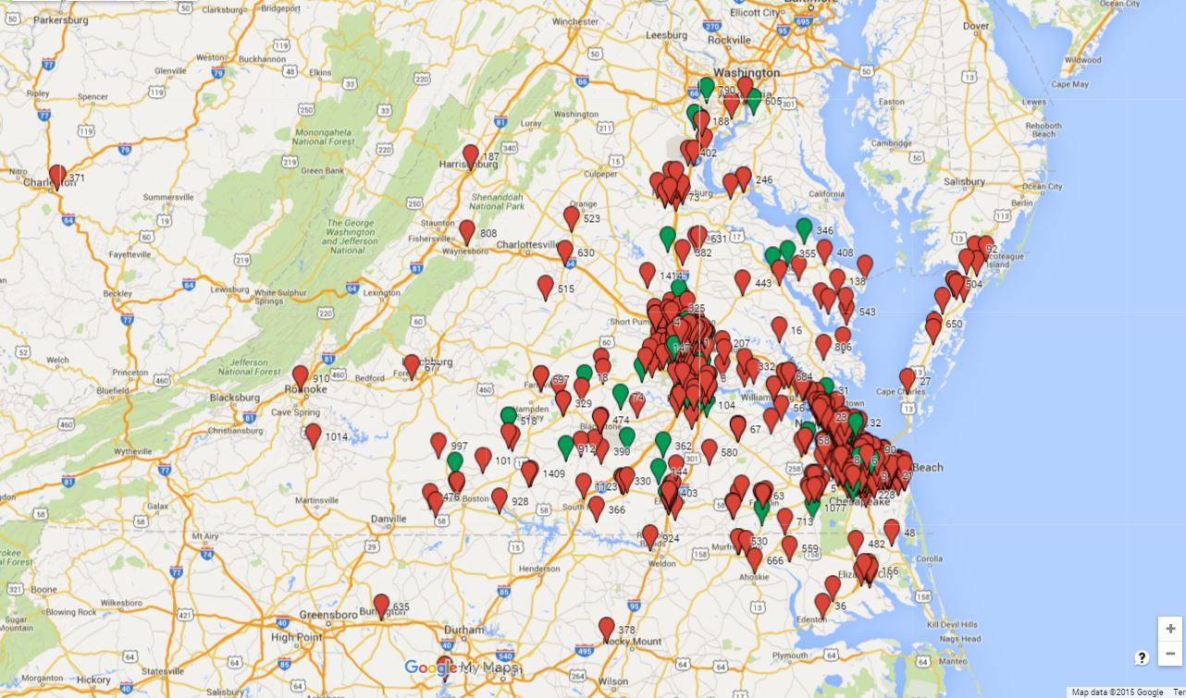
SCD Adult Patients: SHIP HU Contacts (15 yrs or older)

Slide 35
Next Didactic: Sickle Cell Disease: a Vulnerable Population

Slide 36
Case Presentation #2
1:40- 2:00pm [25 min]
Presentation: (5 min)
Case summary: Clinical Hub Lead(5 min)
Clarifying questions- Spokes (participants) 4 min:
Clarifying questions – Hub (4 min):
Recommendations – Spokes (participants) 2 min:
Recommendations – Hub (2 min):
Recap Case /Recommendations- Hub (3 min):

Slide 38
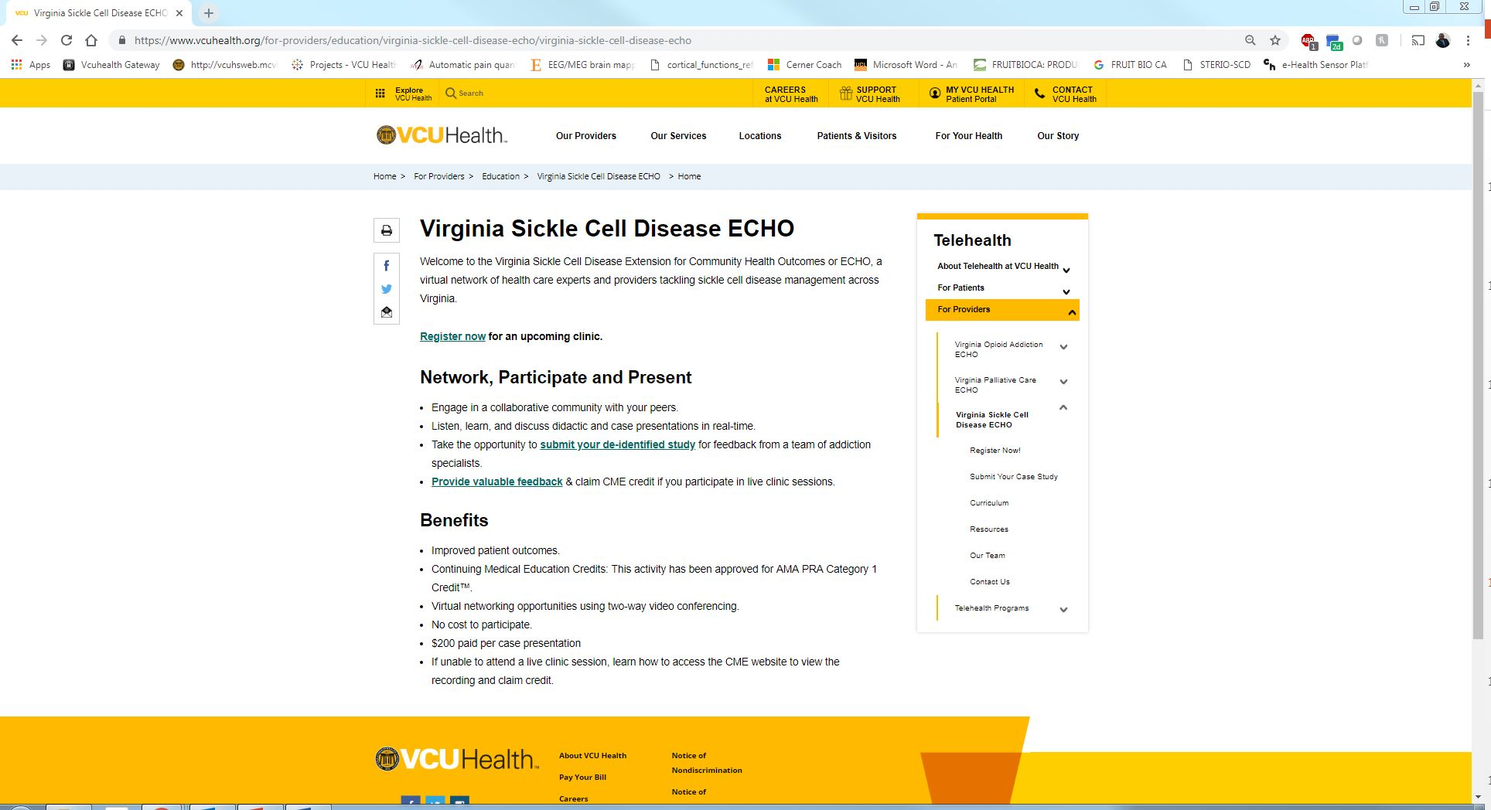
Case Studies

Slide 39
Feedback

Slide 40
Claim Your CME’s

Slide 41
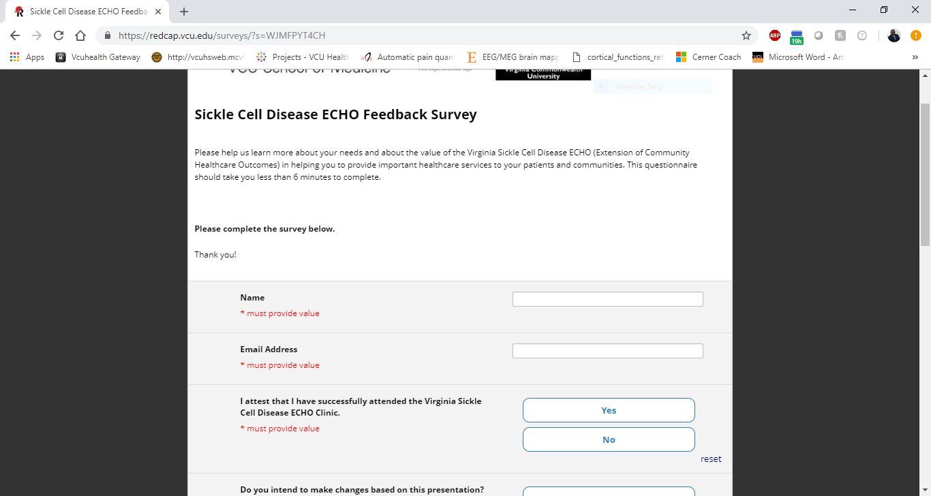
Access Your Evaluation and Claim Your CME

Slide 42
THANK YOU!

